Slide 1
US Unemployment Dashboard
June 13, 2020

Slide 2




The DataVizards Team
Zen Acar
Gina Cameras
Harini Rao
Carlos Santillan

Slide 3
Project Objective:
Create a dashboard to visualize US unemployment trends to understand how COVID-19 has affected unemployment for the following dimensions:
State
Age
Gender
Industry

Slide 4
Datasets & Extraction Method
State-level
Demographic-level
Industry-level
Unemployment claims: oui.doleta.gov/unemploy/claims.asp
2015- present
US Dept of Labor
Weekly data
Extract method: Wget Python module to extract txt files from the web
State population totals: census.gov/data/datasets/
2010 - present
US Census
Yearly data
Extract method: CSV download
Unemployment levels: download.bls.gov/pub/time.series/ln/
2015- present
US Bureau of Labor Statistics
Monthly data
Extract method: Wget Python module to extract txt files from the web
Employment levels: download.bls.gov/pub/time.series/ce/
2015- present
US Bureau of Labor Statistics
Monthly data
Extract method: Wget Python module to extract txt files from the web

Slide 5
Data Transformation
State-level
Demographic-level
Industry-level
Unemployment claims: oui.doleta.gov/unemploy/claims.asp
Fixed data types
Added year_month column
Reconfigured data using .groupby and .agg
State population totals: census.gov/data/datasets/
Added 2020 copying over from 2019 data
Reconfigure data using pd.melt
Unemployment levels: download.bls.gov/pub/time.series/ln/
Filtered series_id column to categories needed
Pared down df to columns needed
Create a new date column combining year & month columns
Renamed category column for better display in Tableau
Employment levels: download.bls.gov/pub/time.series/ce/
Filtered series_id column to categories needed
Pared down df to columns needed
Create a new date column combining year & month columns
Renamed category column for better display in Tableau

Slide 6
Technologies Utilized
Python
Modules - Wget, Pandas, Matplotlib (test plots), datetime, sqlalchemy
Javascript
Leaflet - Create choropleth of state claims
Plot.ly - Create bar chart of state claims
New Library
Tableau - Created demographic and industry level charts for dashboard
CSS/HTML, Database & Other
3 html pages - SQLite connected to Heroku
Integrating RSS feed into Javascript

Slide 7
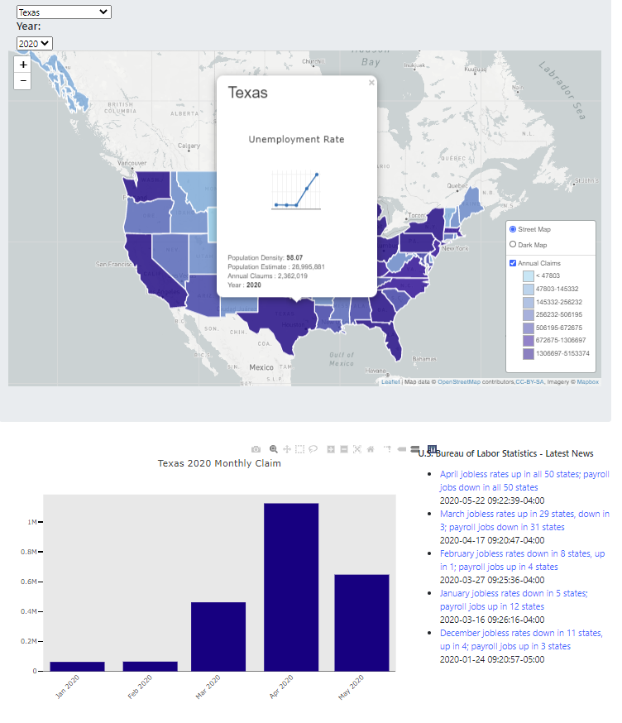
Website Demo
Homepage - State data
Leaflet & Plot.ly
Sub-page - Demographic data
Tableau dashboard/story
Sub-page - Industry data
Tableau dashboard
LINK: App Link
Notes:
Demo Notes: Show interactiveness
Page 1:
Carlos - Choropleth (tooltips, mini charts showing rate, geoJSON, census data, legend)
Zen - Bar chart (dynamic title, interactive with dropdowns) & RSS feed powered by US Bureau of Labor Statistics
Page 2:
Harini - Tableau dash/story (sliders, both pages, types of plots (hbar, area, bubble, grid)
Page 3:
Gina - Tableau dash (hbar, date drop-down, legend, top 10)

Slide 8
Technical Hurdles
Data Structure
Structuring the data in a format needed to create the plots took a few attempts.
Detail:
First we pivoted the data by category, but it was too “flat”. We then re-formatted and it made it easier to chart the data.
Decided to rename categories in Python to better format Tableau plots.
Javascript
Making Javascript code cohesive between the team.
Detail:
Combined Leaflet and Plot.ly code in one app.js file
Ensured the functions worked properly together across the file and combined functions where possible.

Slide 9
Questions ?

